Slide 1
CSG2005 Computer Vision & Robotics
Dr Mayuri A v r
Senior assistant professor
ViT bhopal

Slide 2
Image Formation - Radiometry
Measurement of light
Image – pixel intensity depends upon amount of light reflected by surface
Photometry – measure sensitivity of camera / eyes

Slide 3
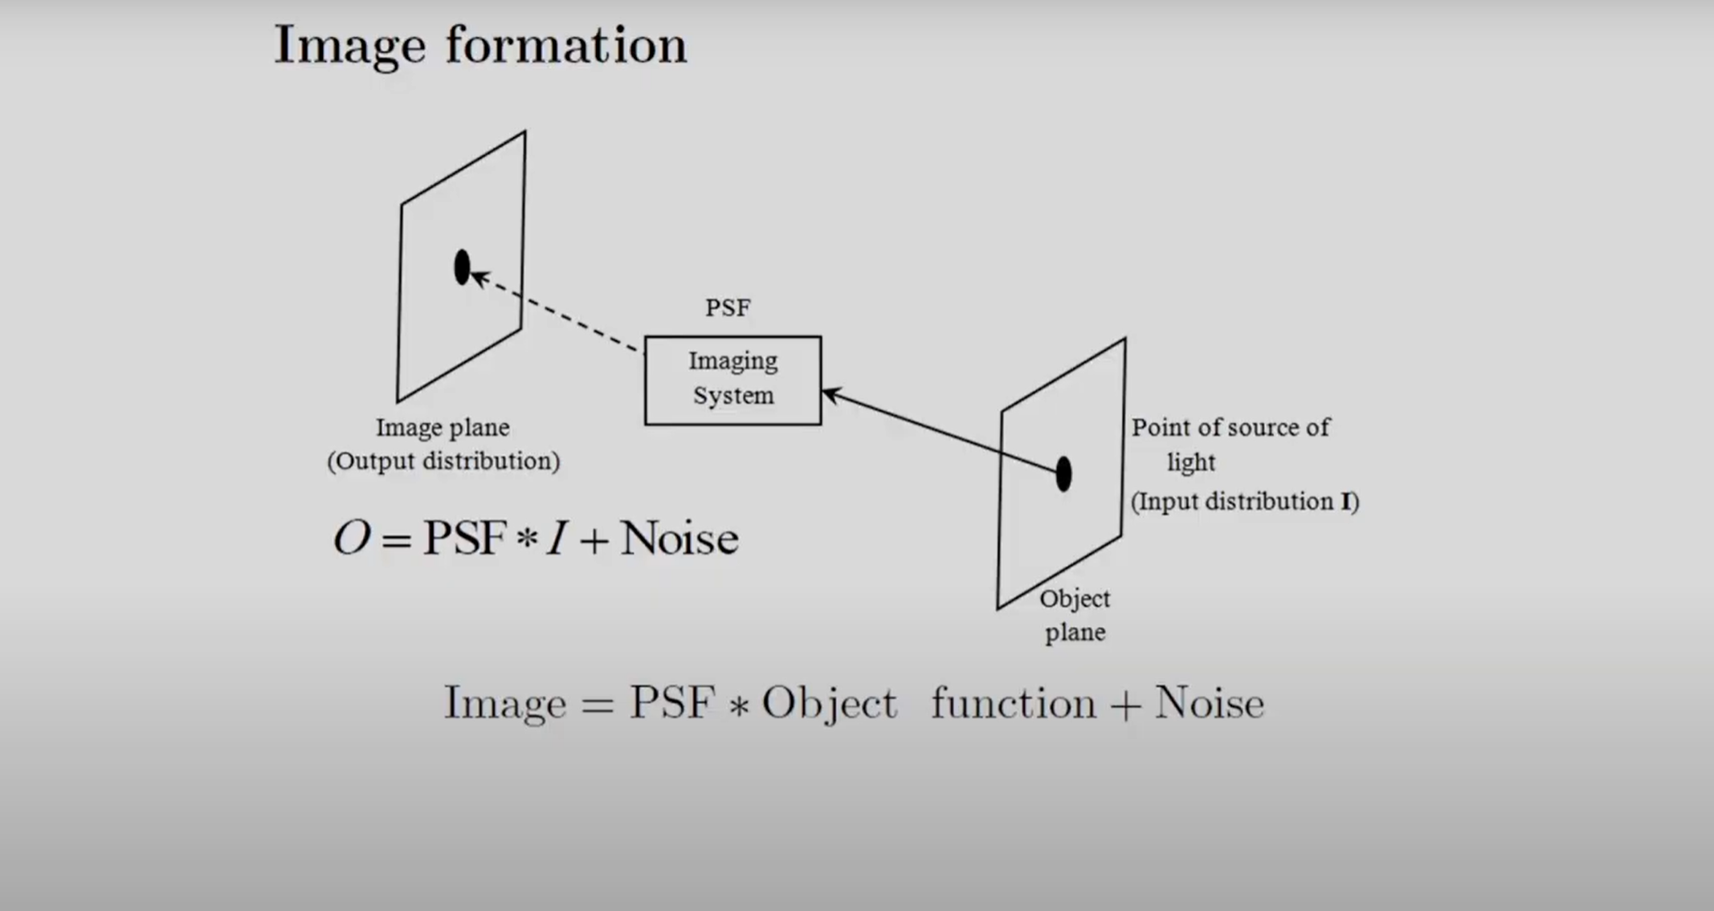

Slide 4
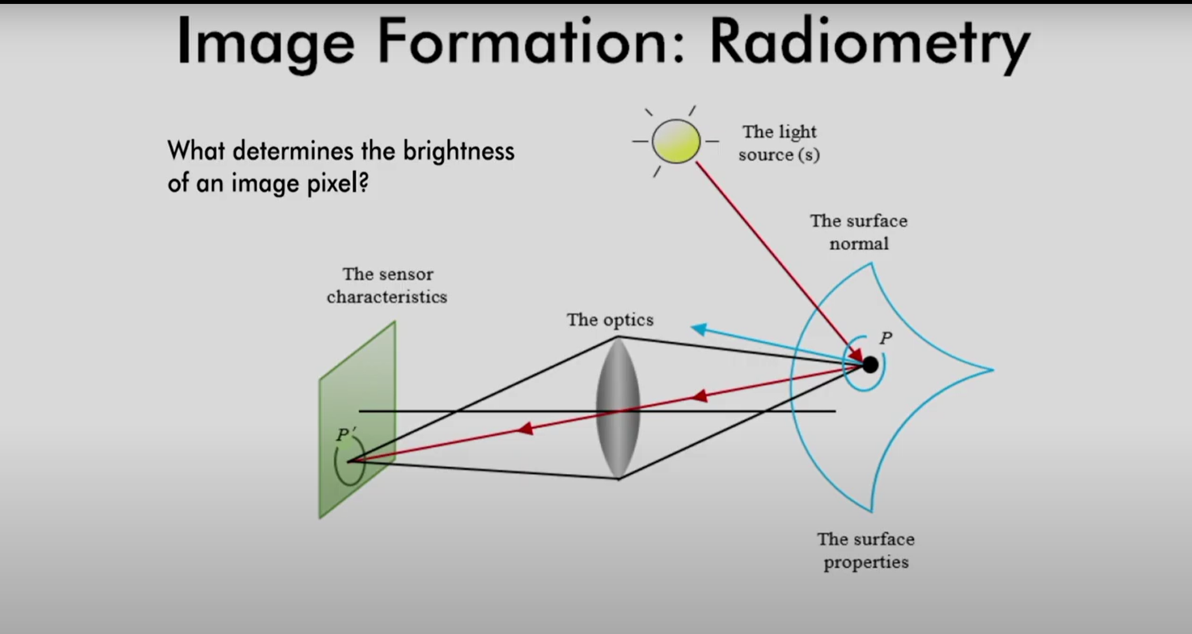

Slide 5
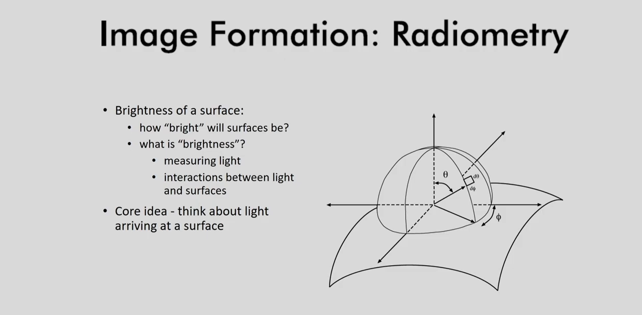

Slide 6
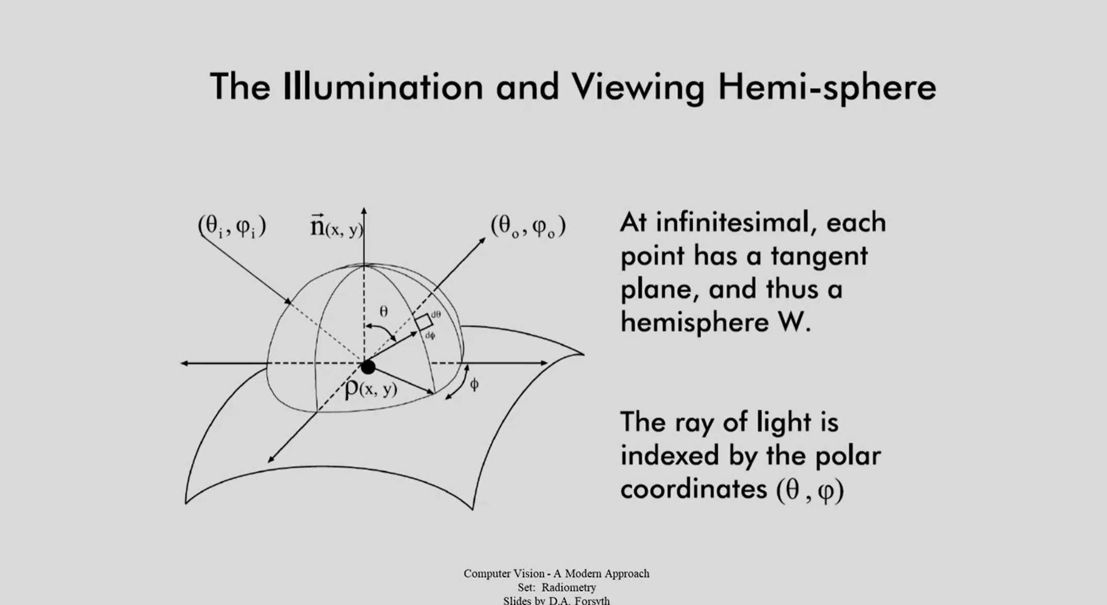

Slide 7
Watch this!
https://youtu.be/aWspVHOy2-4

Slide 8
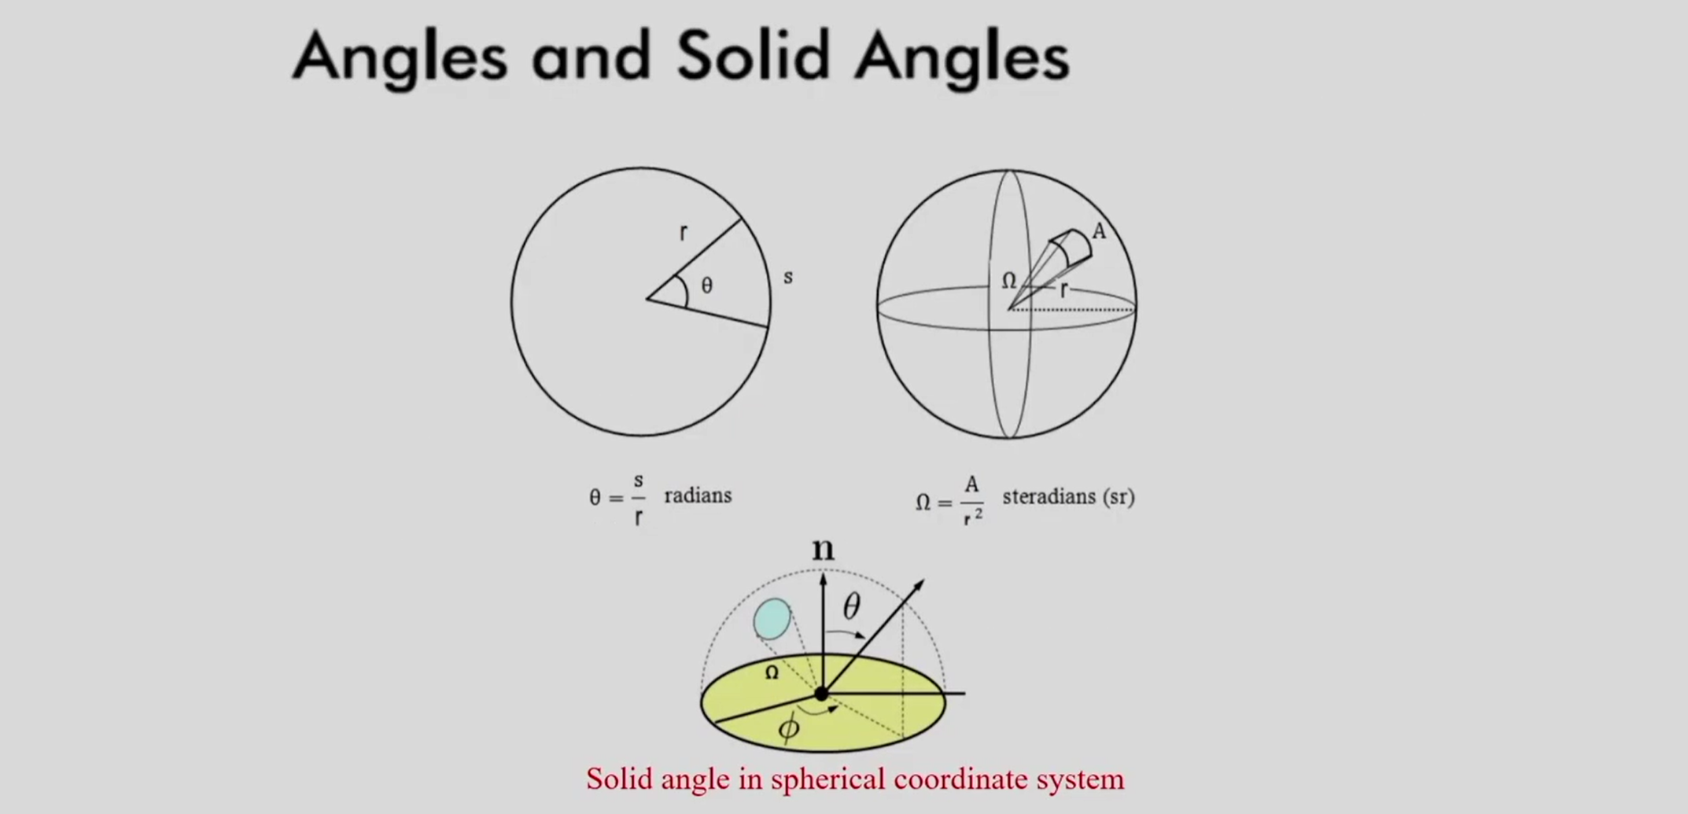

Slide 9
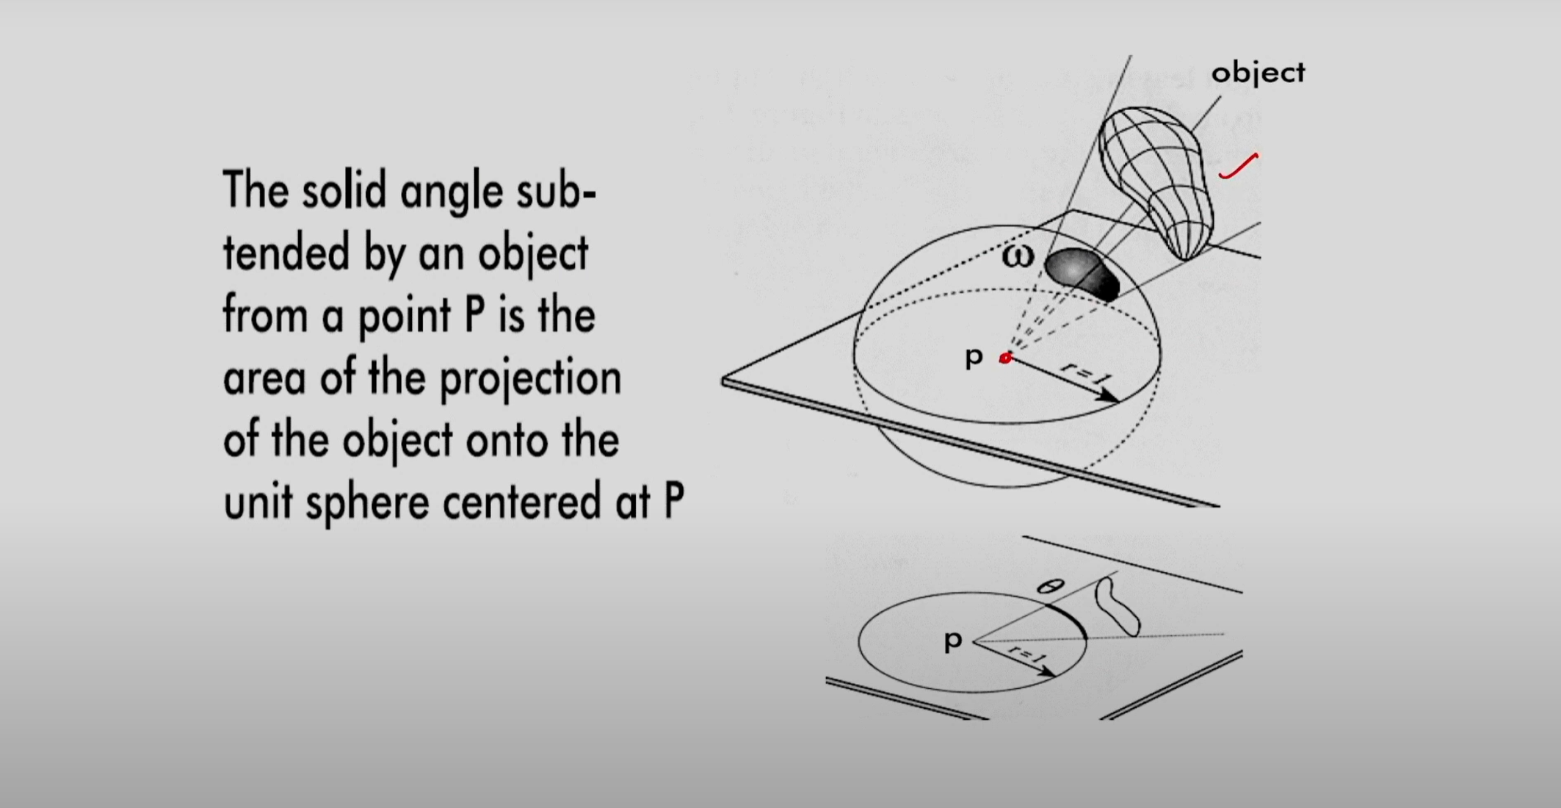

Slide 10
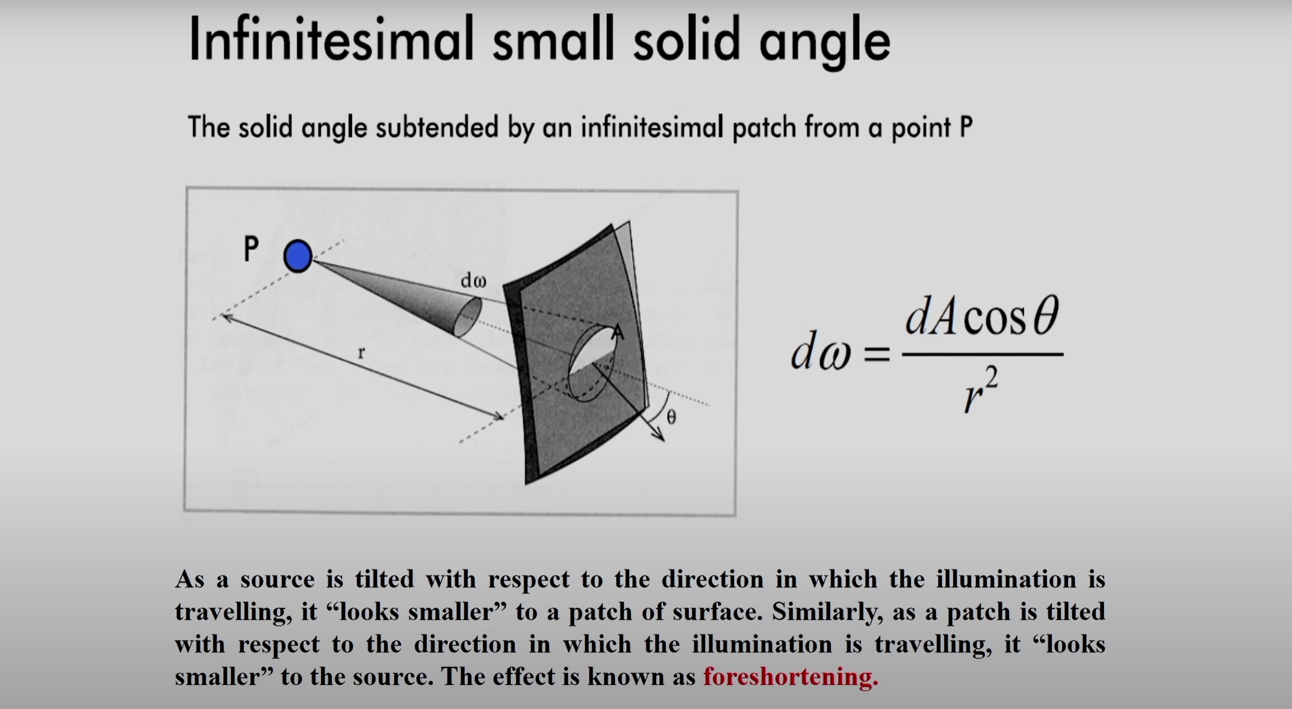

Slide 11
Foreshortening – watch this!
https://youtu.be/UH48lUQP5XQ

Slide 12
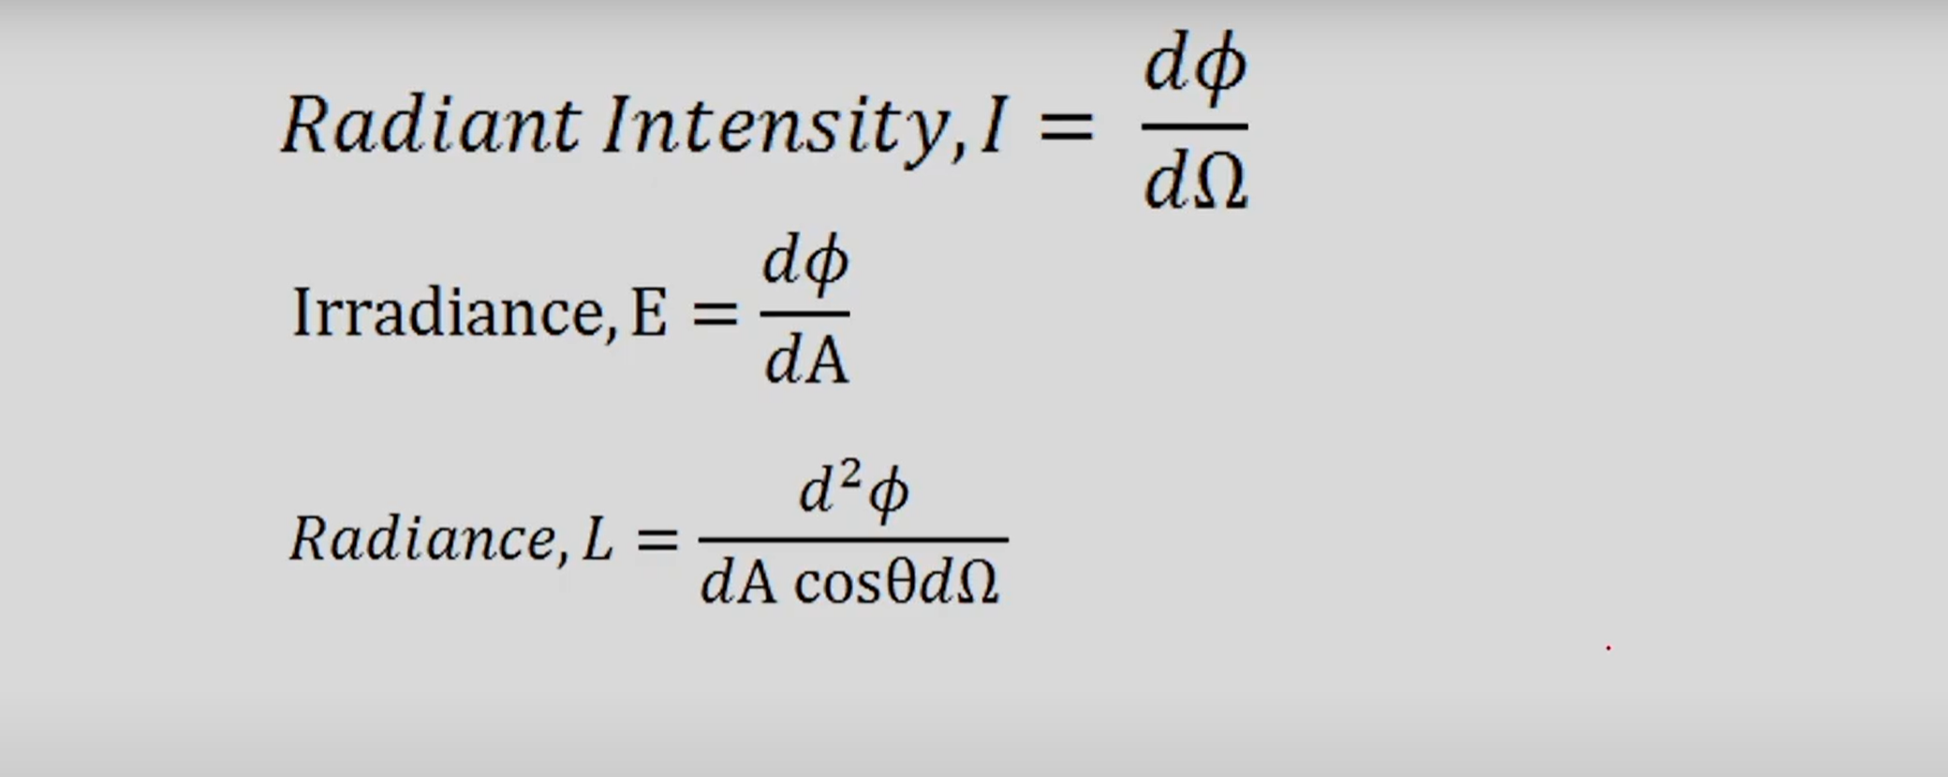

Slide 13
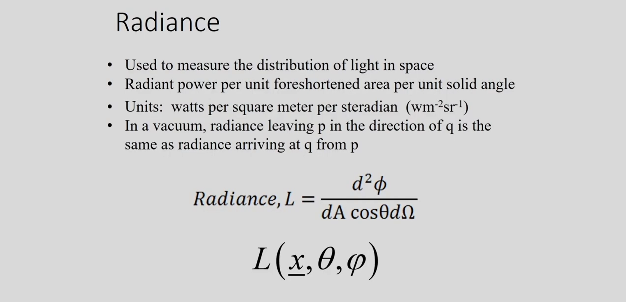

Slide 14
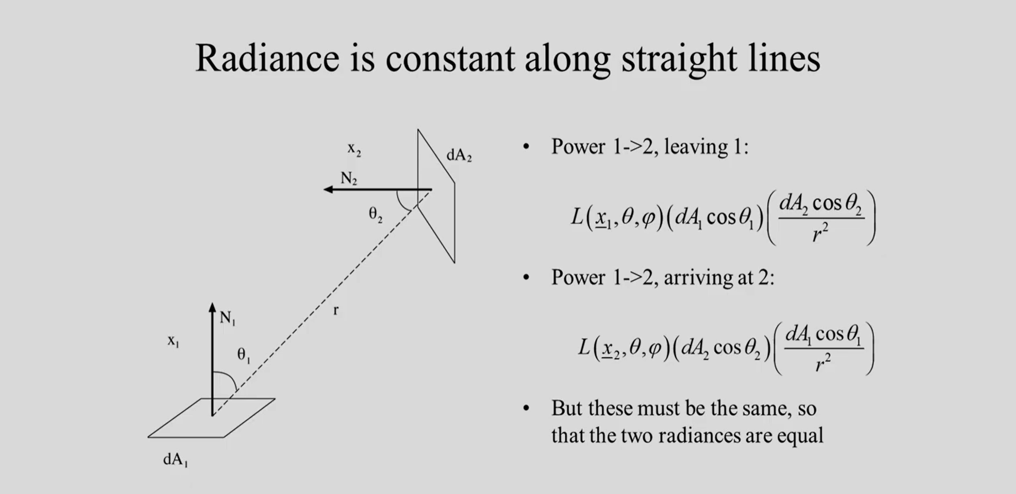

Slide 15
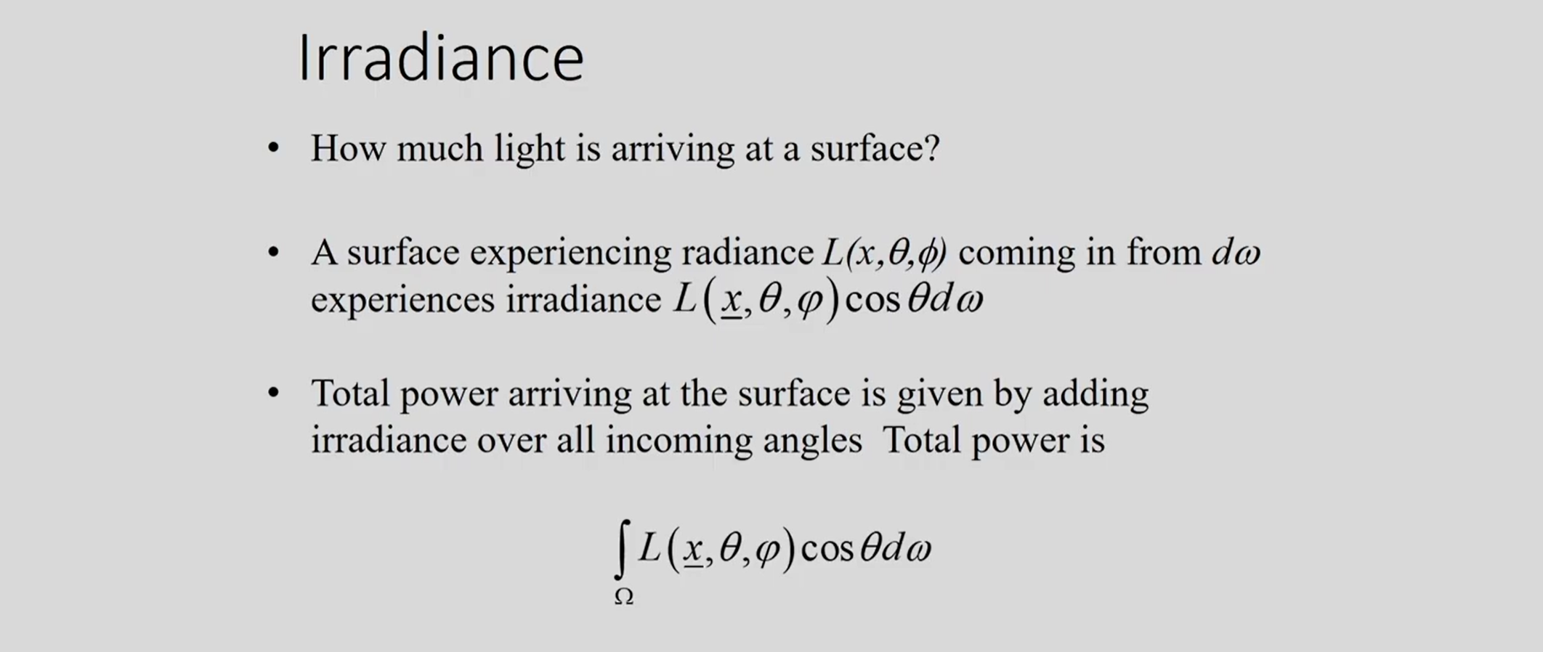

Slide 16
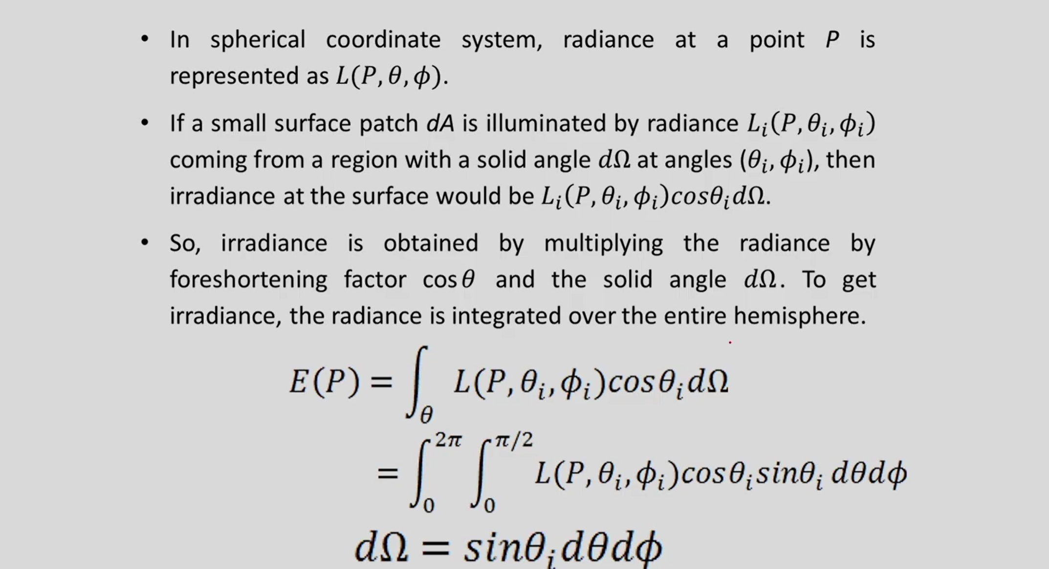

Slide 17
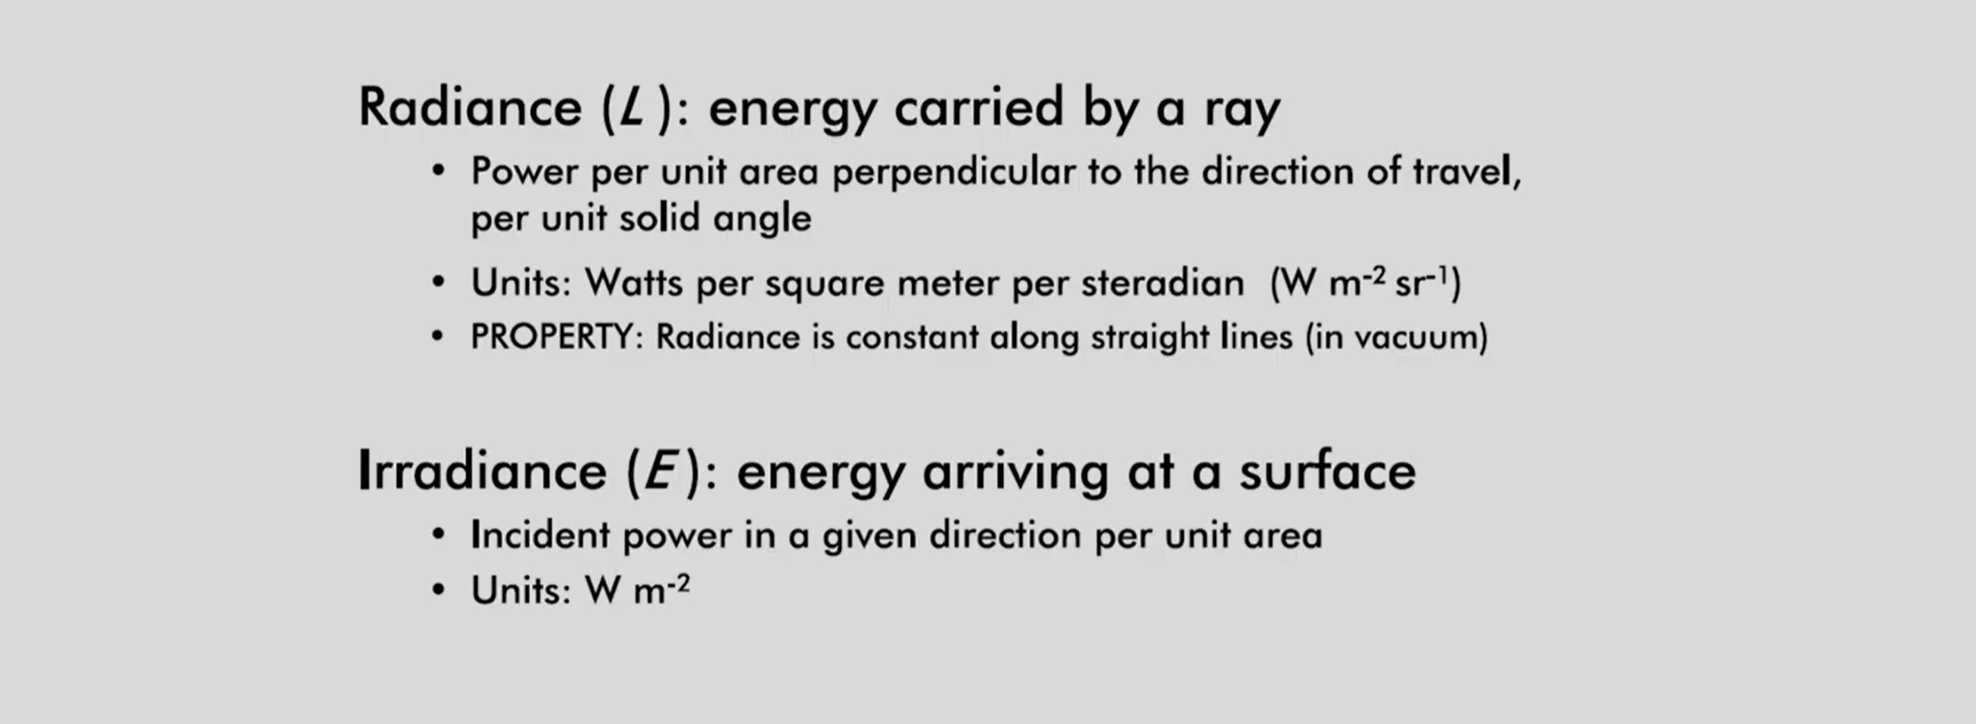

Slide 18
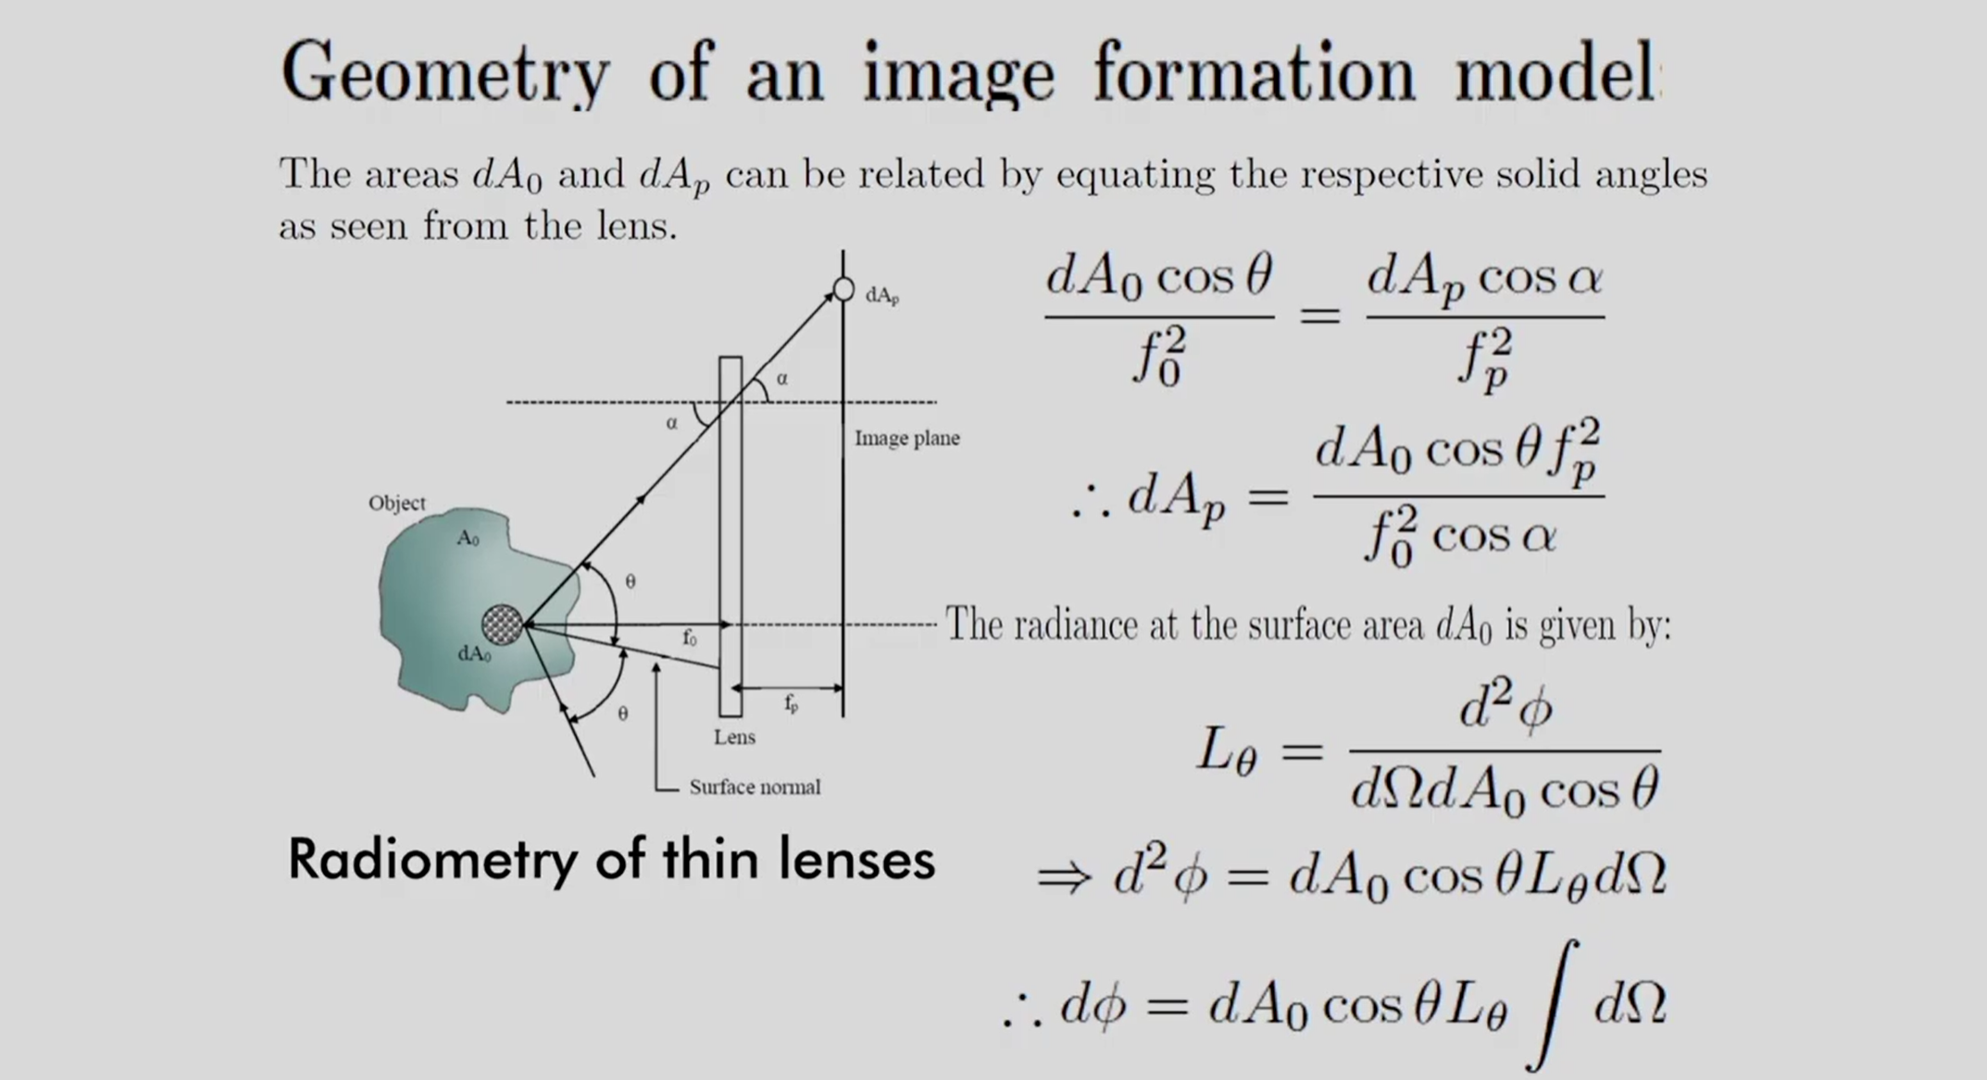

Slide 19
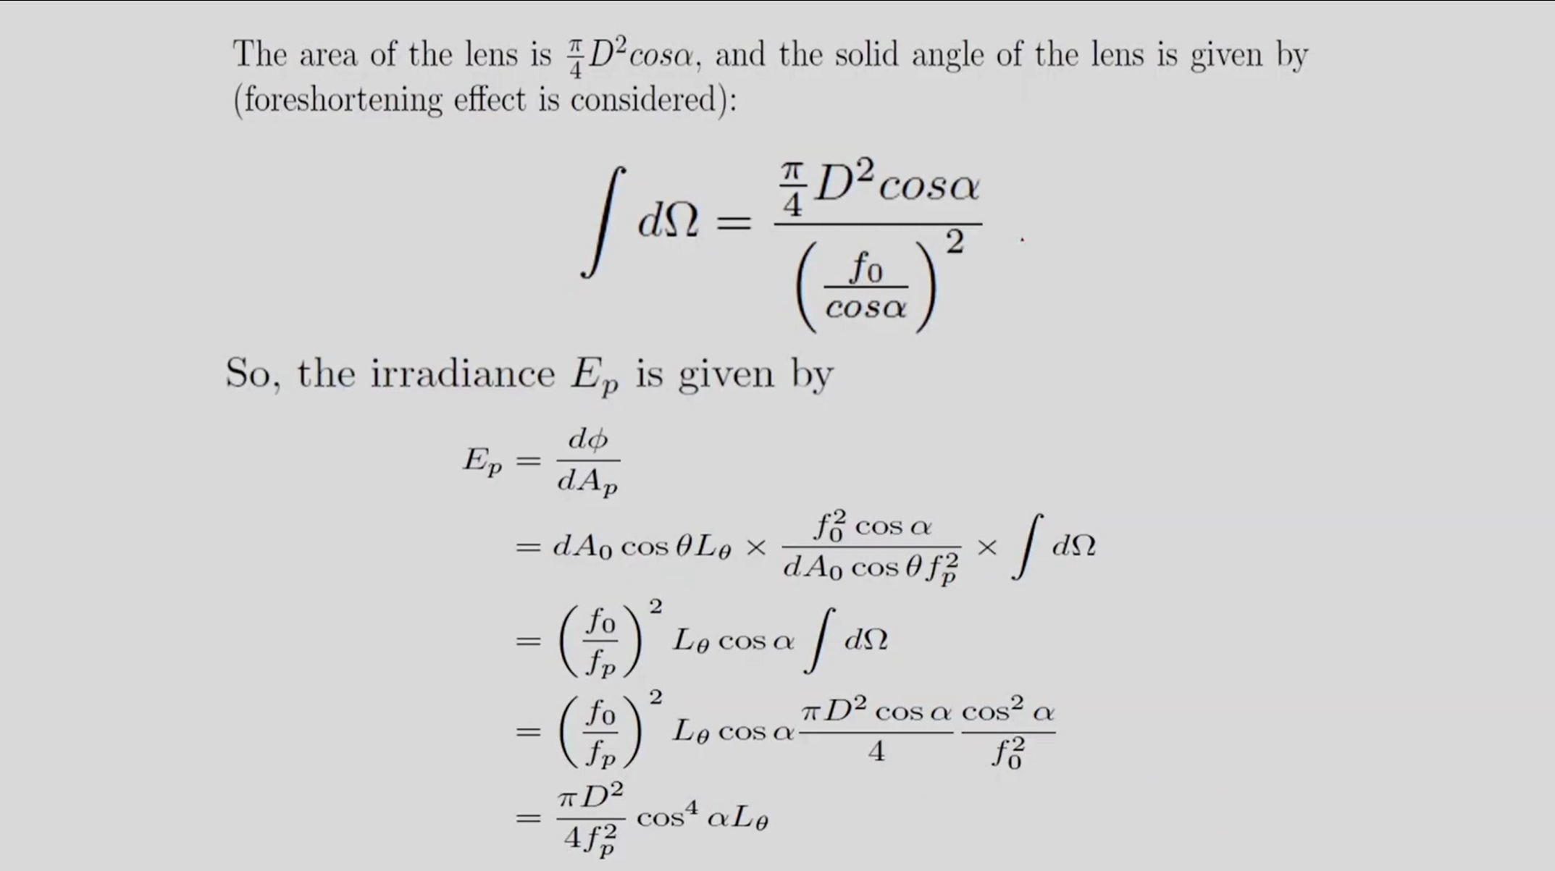

Slide 20
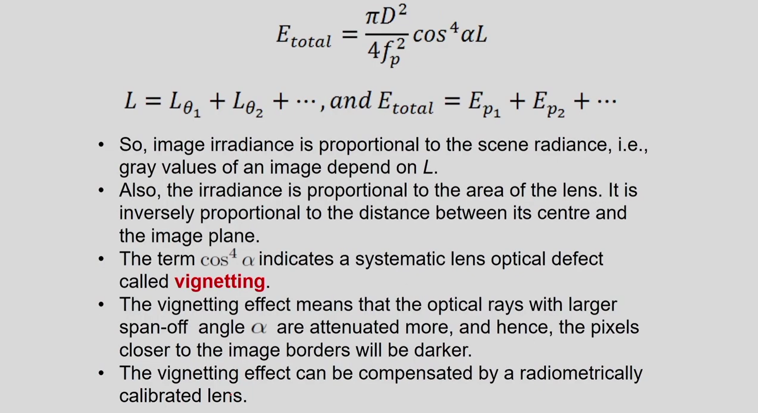

Slide 21
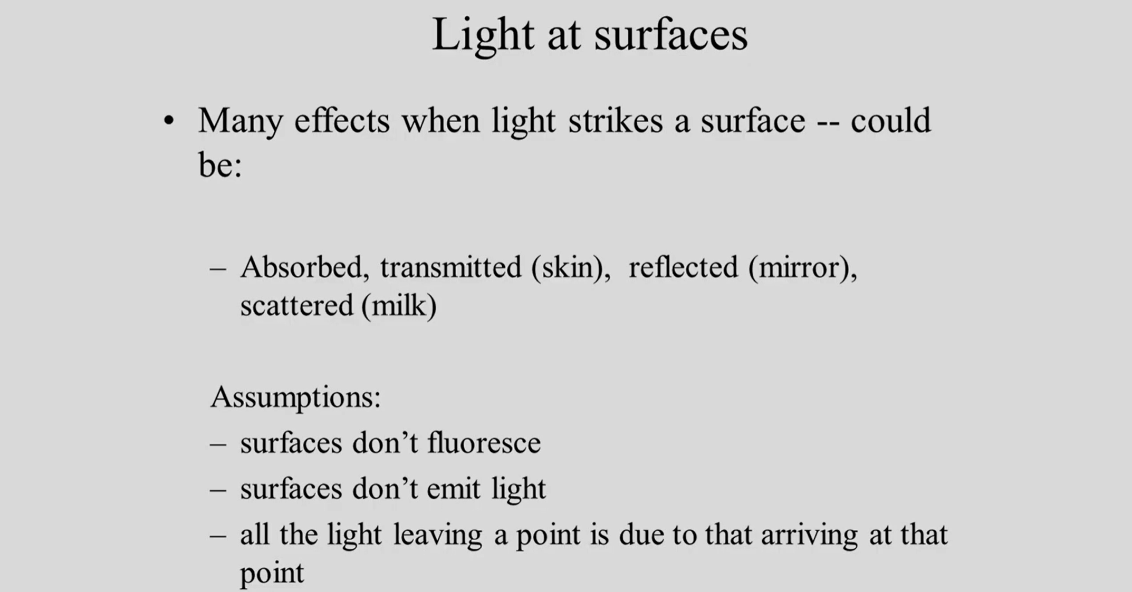

Slide 22
Watch this
https://youtu.be/4QXE52mswIE

Slide 23
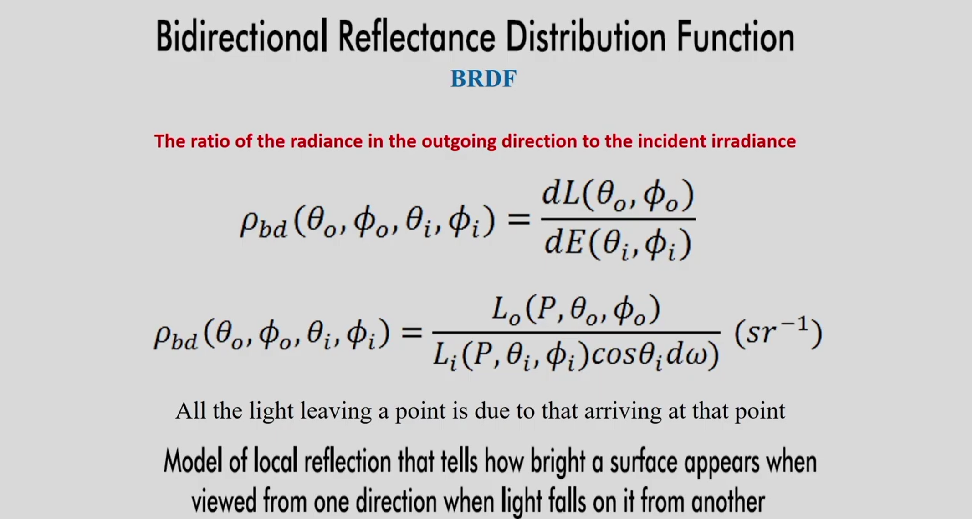

Slide 24
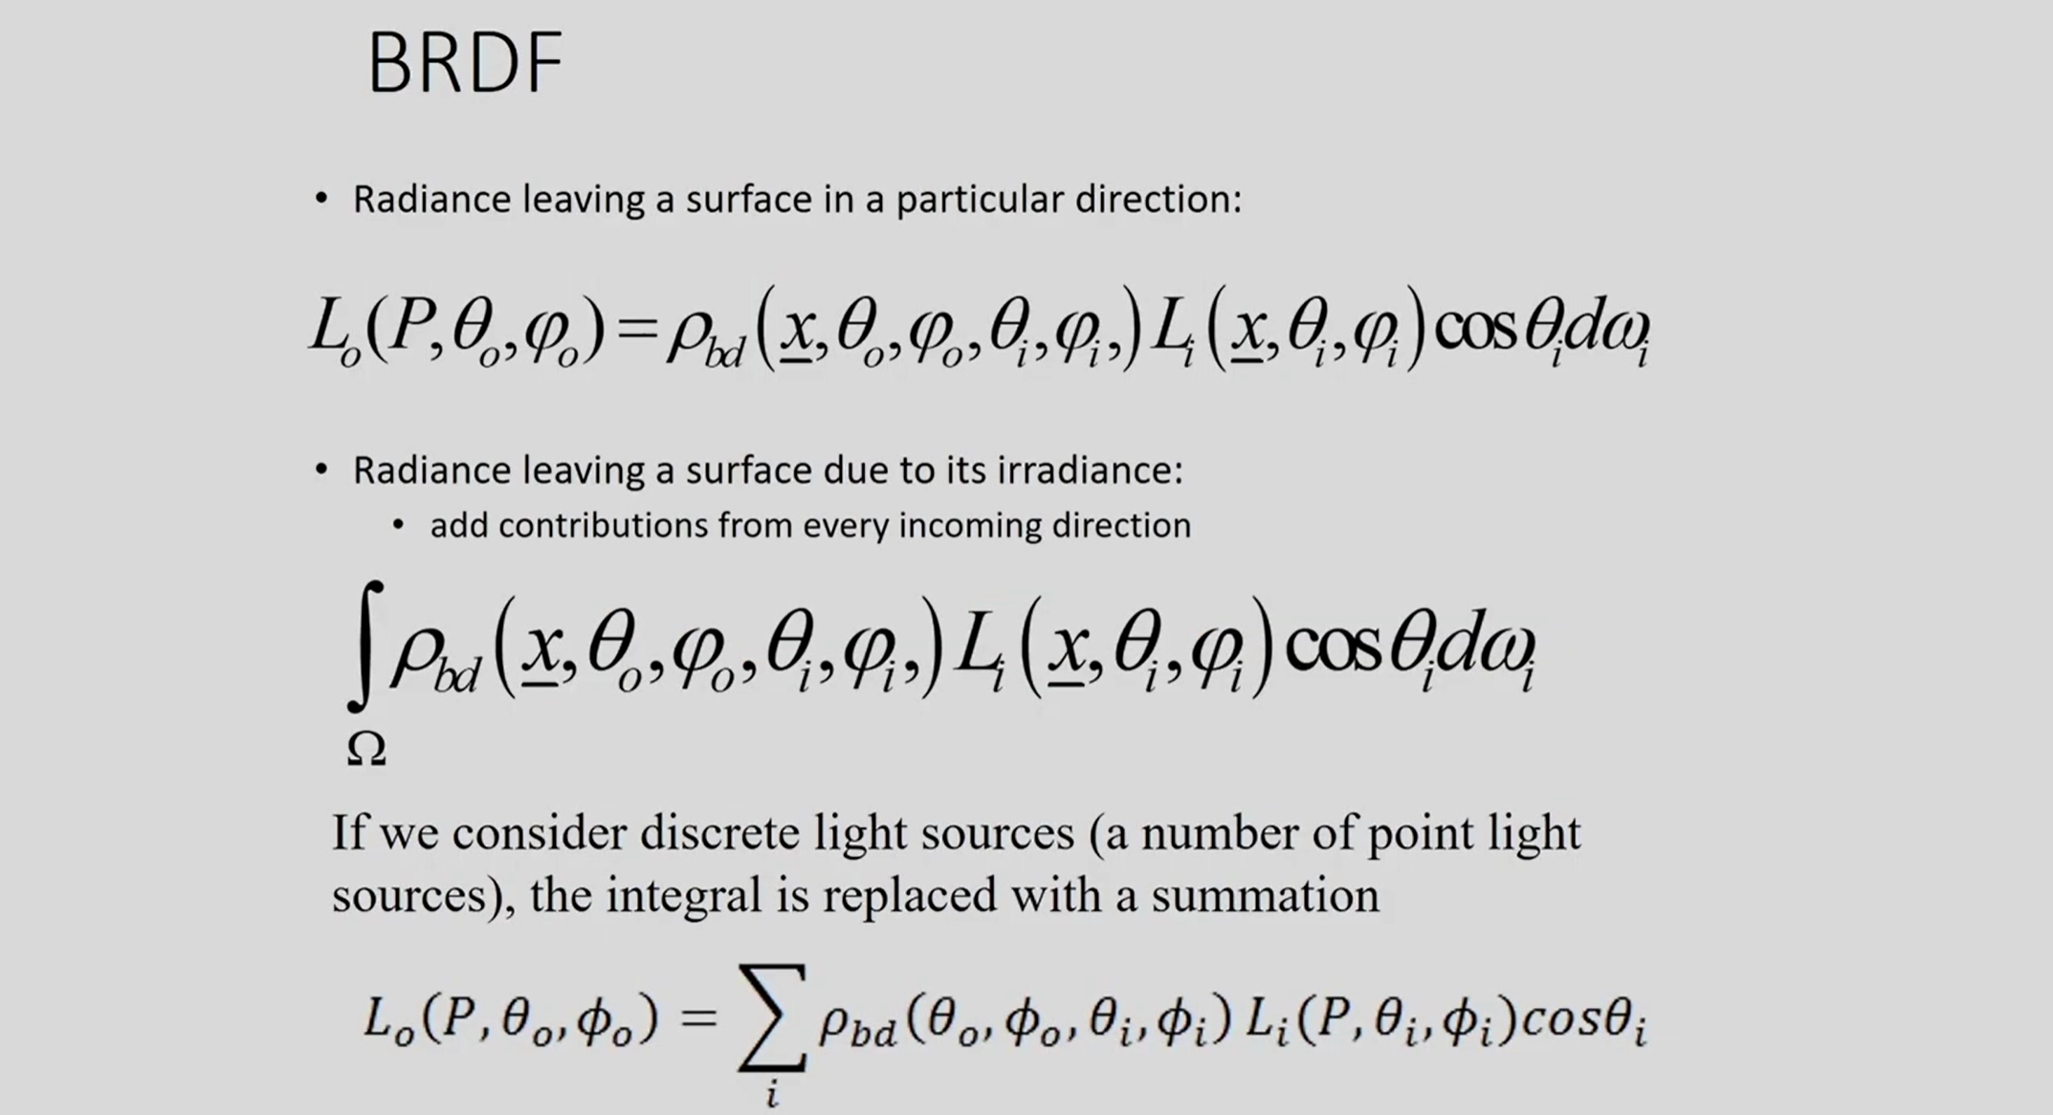

Slide 25
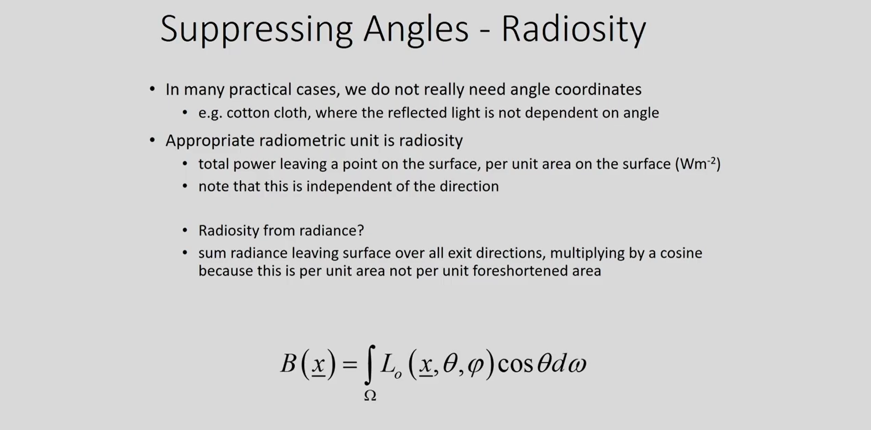

Slide 26
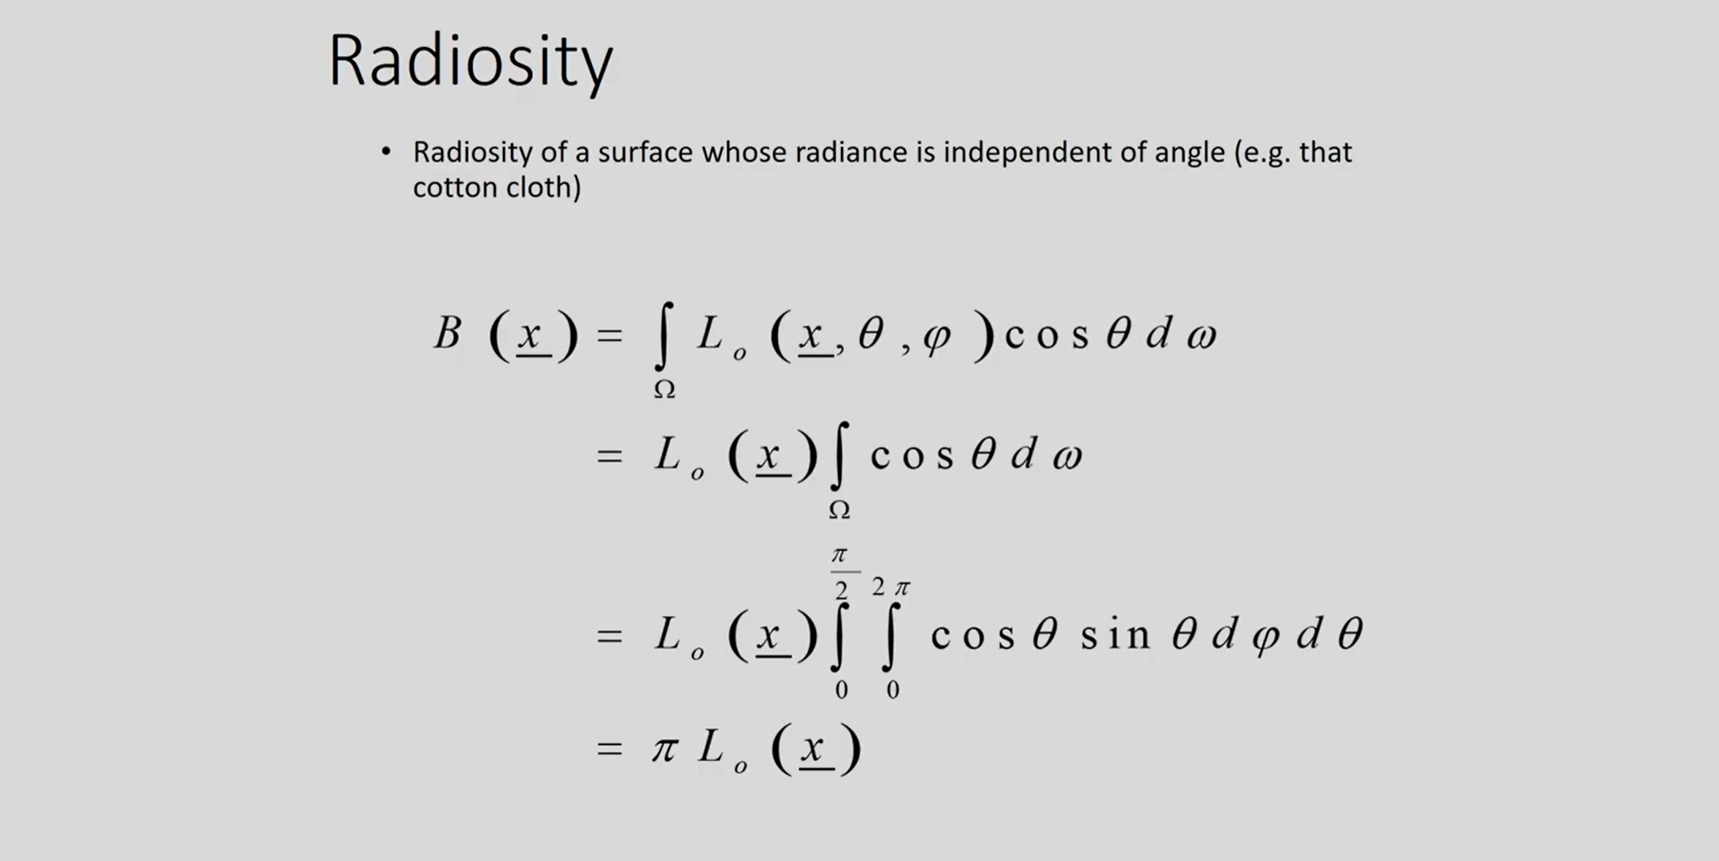

Slide 27
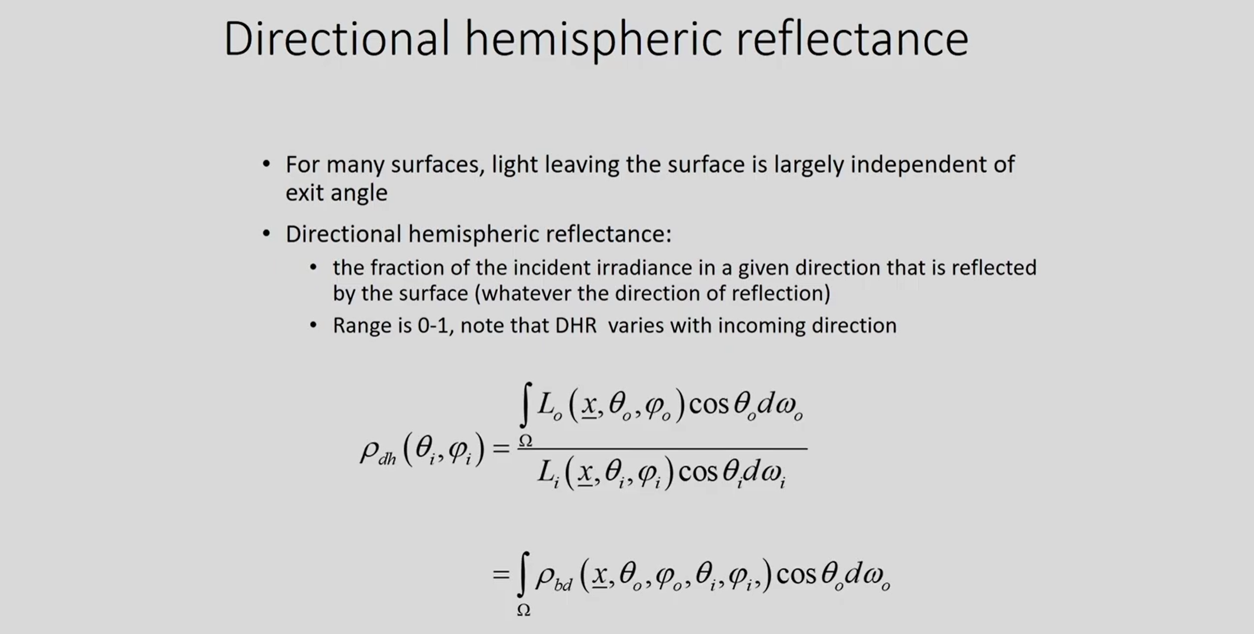

Slide 28
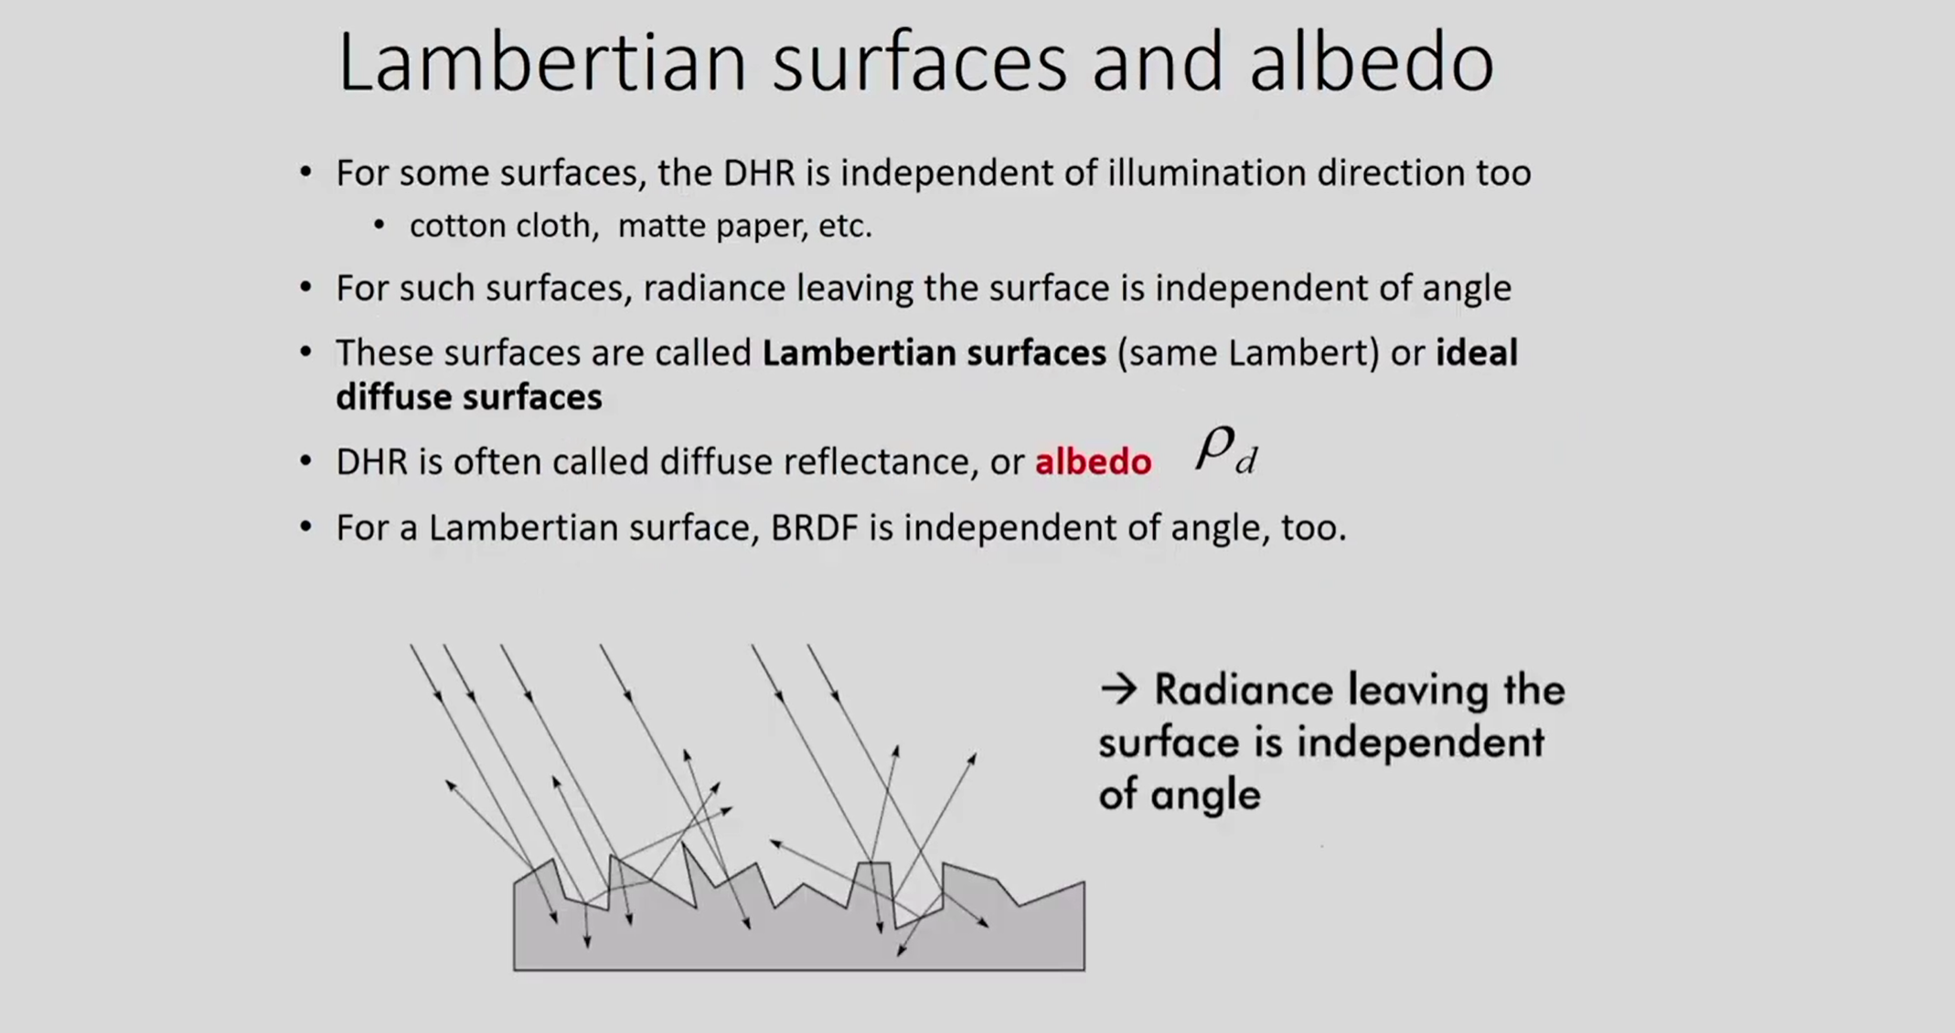

Slide 29
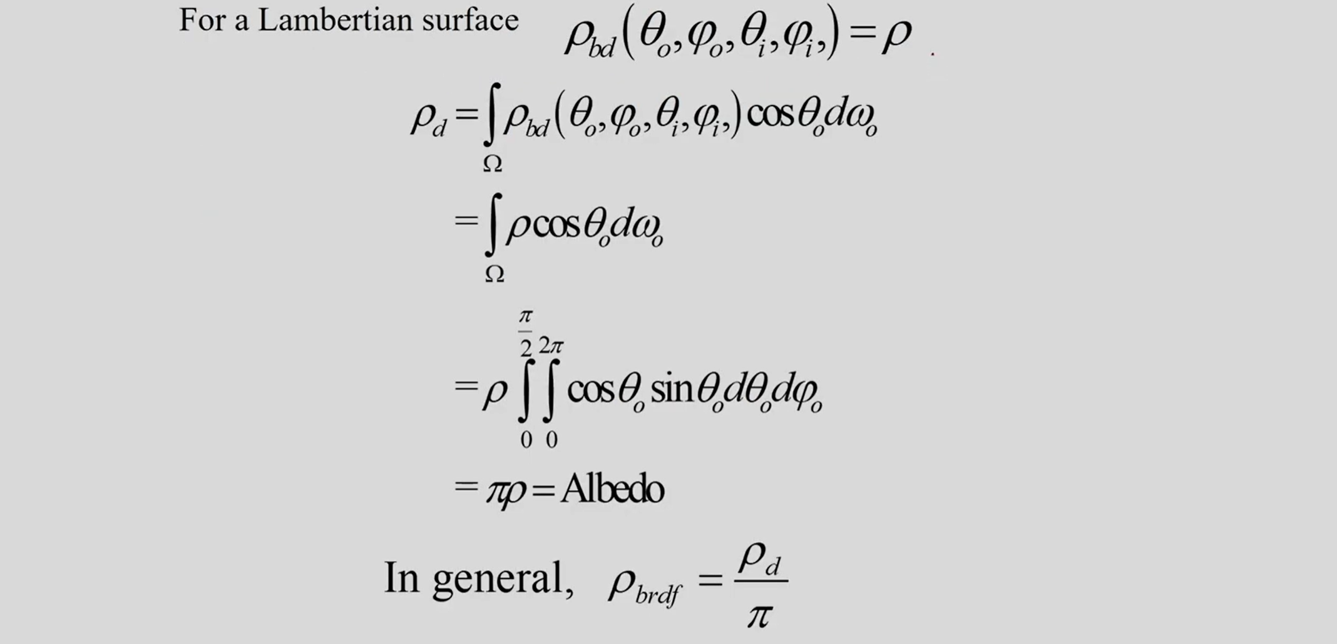

Slide 30
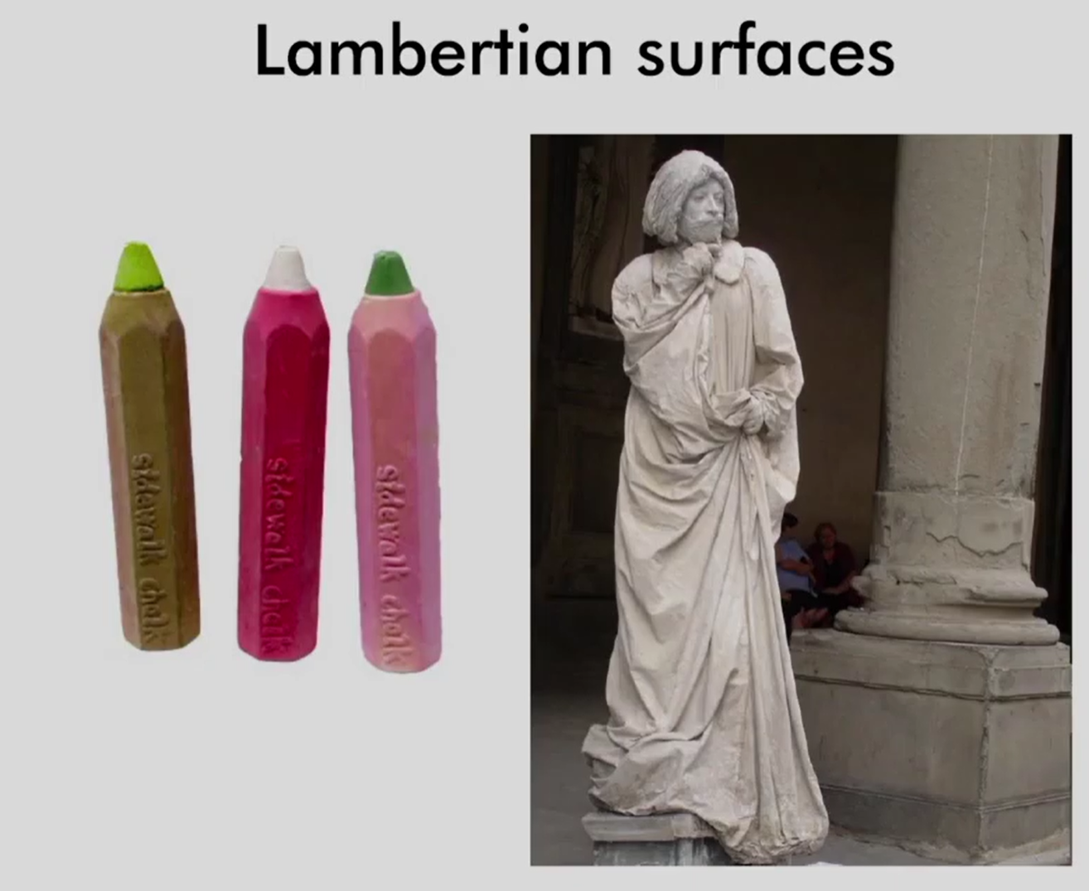

Slide 31
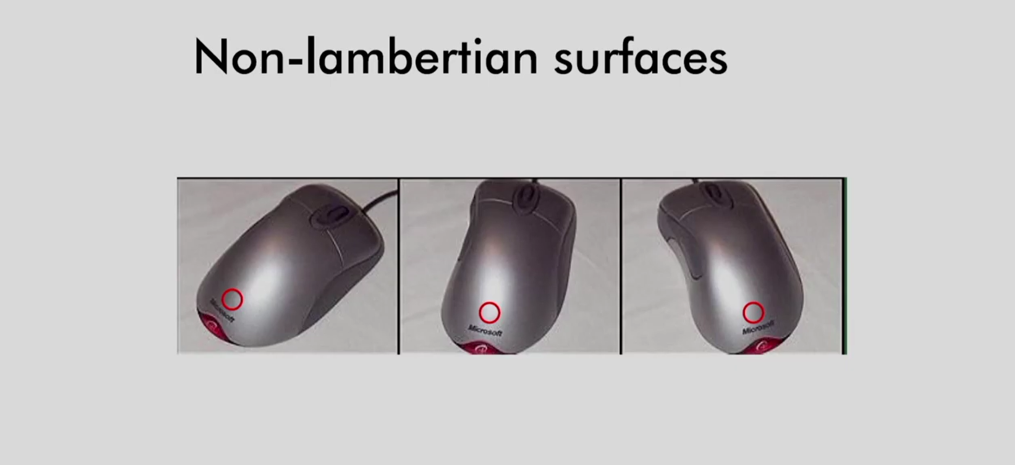

Slide 32
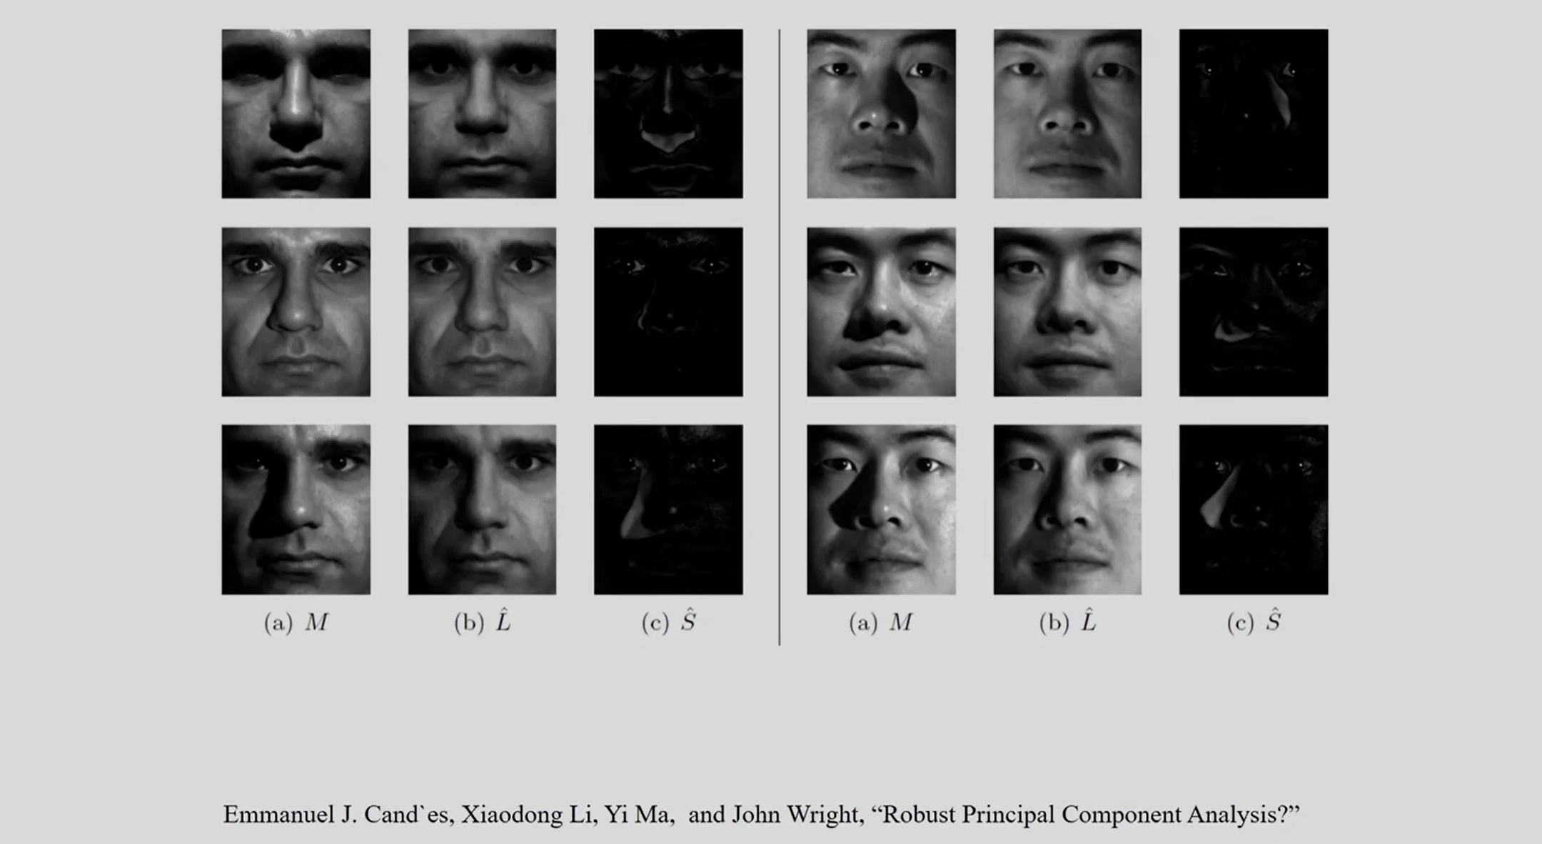

Slide 33
Watch This
https://youtu.be/_2DnjUz0YYE

